Slide 1
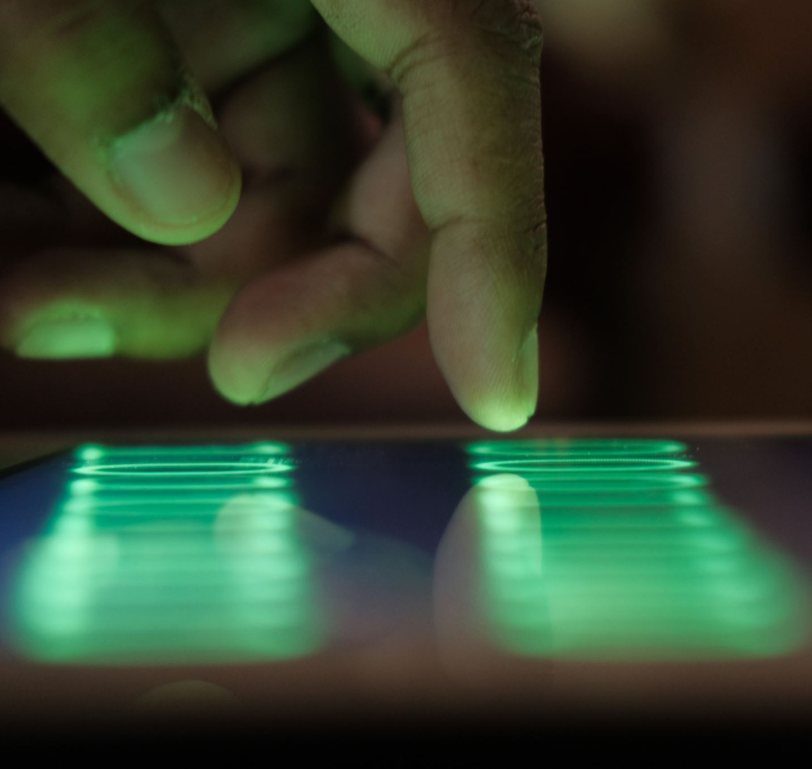
HAND TRACKING AND HAND SIGN DETECTION
Cs mini project
Submitted by
GOPAVRAM CHAKRADHAR-211ME215
IVS RAMCHARAN-211ME217

Slide 2

Problem statement:
This project aims to build a software that could recognise hand gestures

Slide 3
1.DESIGN AND PLAN OF THE PROJECT:
This python project deals with hand tracking and sign detection by using Google’s Mediapipe and OpenCV. This project is basically useful for deaf people who are not that comfortable with the sign language. We have used many other famous concepts such as functions , classes and famous modules such as Tensorflow and Numpy. Our code can detect many hand gestures through webcam.

Slide 4
This project contains the following contents.
Sample code
Hand sign recognition model(TFLite)
Finger gesture recognition model(TFLite)
We have successfully completed the code, and it is being executed. All the expected parameters were met without errors.

Slide 5
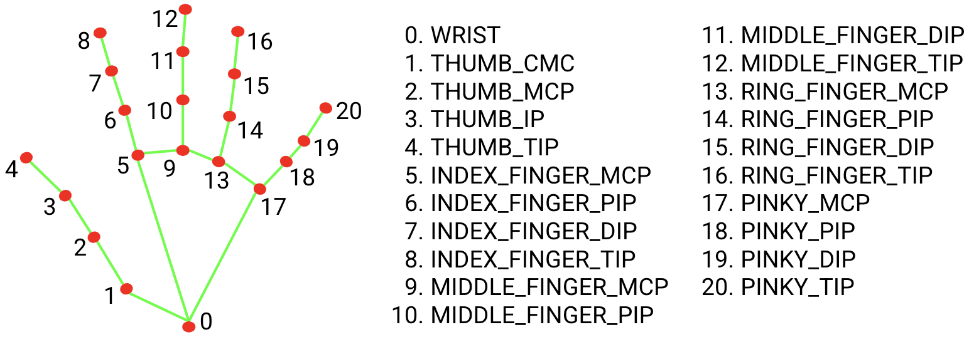
MEDIAPIPE
The ability to perceive the shape and motion of hands can be a vital component in improving the user experience across a variety of technological domains and platforms.
MediaPipe Hands is a high-fidelity hand and finger tracking solution. It employs machine learning (ML) to infer 21 3D landmarks of a hand from just a single frame. Whereas current state-of-the-art approaches rely primarily on powerful desktop environments for inference, our method achieves real-time performance on a mobile phone, and even scales to multiple hands.

Slide 6

OPENCV
OpenCV (Open Source Computer Vision Library) is an open source computer vision and machine learning software library. OpenCV was built to provide a common infrastructure for computer vision applications and to accelerate the use of machine perception in the commercial products.

Slide 7
Approach
Step1- Run the code
Step2- Webcam will be turned on in 10-15 seconds approximately.
Step3- Show the hand gestures like thumbsup, peace sign etc.
Step4- Sample program will recognize the handgestures from the pre trained model
Step5- It will display the most accurate handgesture types

Slide 8
DATA COLLECTION FROM USER
1. Press "k" to enter the mode to save key points(displayed as 「MODE:Logging Key
Point)
2. If you press "0" to "9", the key points will be added to "model/keypoint_classifier/ keypoint.csv"
3. Model training
Open "keypoint_classification.ipynb" in Jupyter Notebook and execute from top to bottom. To change the number of training data classes, change the value of "NUM_CLASSES = 6" and modify the label of "model/keypoint_classifier/ keypoint_classifier_label.csv" as appropriate.

Slide 9
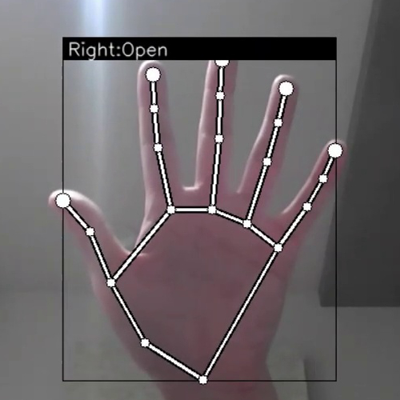
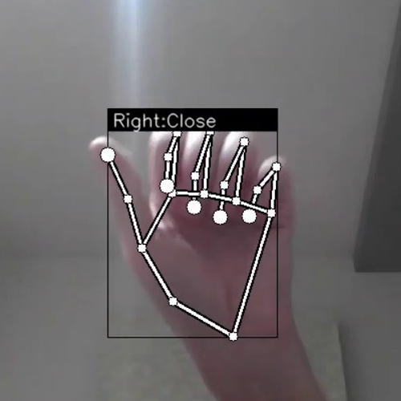
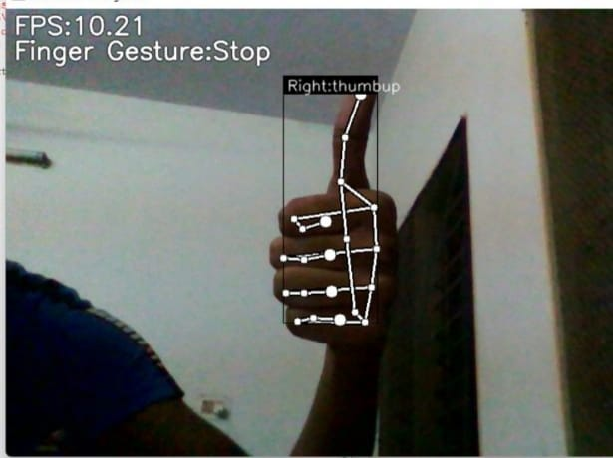
OUTPUT

Slide 10

THANK YOU

